Slide 1
WEEK 3 LECTURES
Shadowing, Combined pathloss and shadowing, Outage ProbabilIty, Cell Coverage Area, Solving problems – Brewster angle, Solving problems –empirical model, Solving problems – friis transmission formula
Courtesy:
Rappaport T.S, “Wireless Communications: Principles and Practice”, Pearson education.

Slide 2
Indoor Models
Indoor Channels are different from traditional channels in two ways
1.The distances covered are much smaller
2.The variability of environment is much greater for a
much small range of Tx and Rx separation.
Propagation inside a building is influenced by:
- Layout of the building
- Construction materials
- Building Type: office , Home or factory
Floor losses, Partition losses, Penetration losses

Slide 3
Indoor Models
Indoor models are dominated by the same mechanism as out door models:
- Reflection, Diffraction and scattering
Conditions are much more variable
- Doors/Windows open or not
- Antenna mounting : desk ceiling etc
- The levels of floor
Indoor models are classifies as
- Line of sight (LOS)
- Obstructed (OBS) with varying degree of clutter

Slide 4
Indoor Models
Portable receiver usually experience
- Rayleigh fading for OBS propagation paths
- Ricean fading for LOS propagation path
Indoors models are effected by type of building e.g. Residential buildings, offices, stores and sports area etc.
Multipath delay spread
- Building with small amount of metal and hard partition
have small delay spread 30 to 60ns
- Building with large amount of metal and open isles
have delay spread up to 300ns

Slide 5
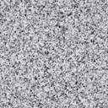
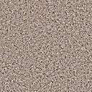
Shadowing
X_{c}
Models attenuation from obstructions
Random due to random # and type of obstructions
Typically follows a log-normal distribution
dB value of power is normally distributed
μ=0 (mean captured in path loss), 4<σ<12 (empirical)
LLN used to explain this model
Decorrelated over decorrelation distance X_{c}

Slide 6
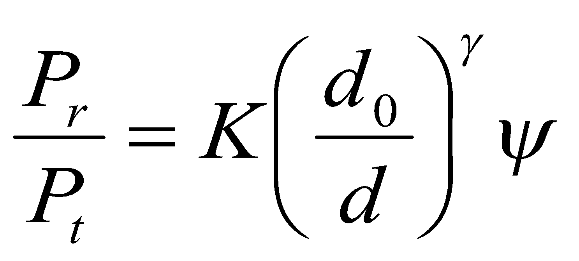
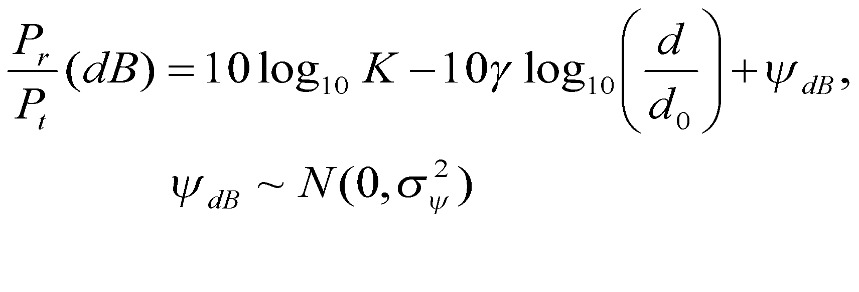
Combined Path Loss and Shadowing
Linear Model: ψ lognormal
dB Model
10logΚ
Slow
P_{r}/P_{t}
(dB)
Very slow
-10γ
log d

Slide 7
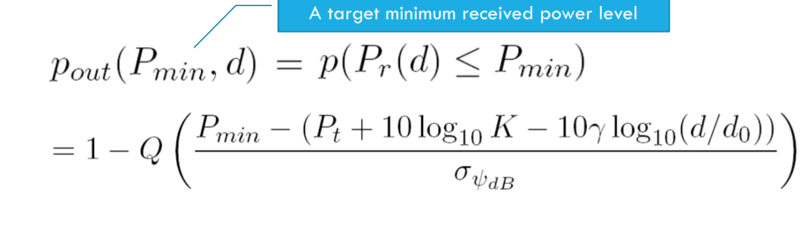
Outage Probability under path loss and shadowing

Slide 8
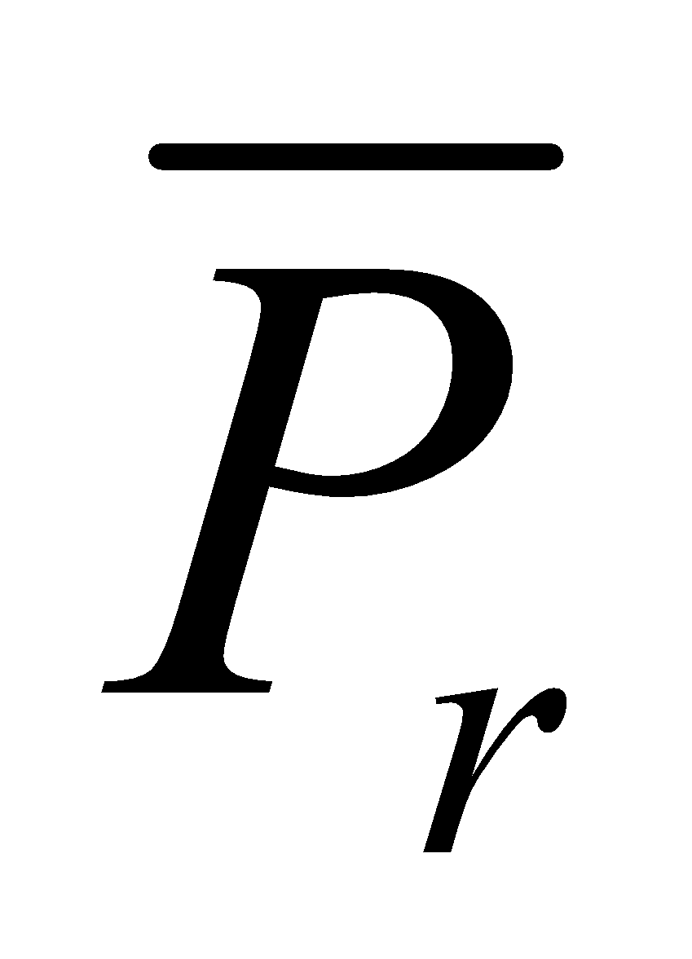
Cell Coverage Area
Path loss: circular cells
Path loss+shadowing: amoeba cells
Tradeoff between coverage and interference
Outage probability
Probability received power below given minimum
Cell coverage area
% of cell locations at desired power
Increases as shadowing variance decreases
Large % indicates interference to other cells
_{(Wireless Communications by}
_{Andrea Goldsmith)}

Slide 9
Main Points
Random attenuation due to shadowing modeled as log-normal (empirical parameters)
Shadowing decorrelates over decorrelation distance
Combined path loss and shadowing leads to outage and amoeba-like cell shapes
Cellular coverage area dictates the percentage of locations within a cell that are not in outage
Path loss and shadowing parameters are obtained from empirical measurements

Slide 10
NUMERICALS

Slide 11
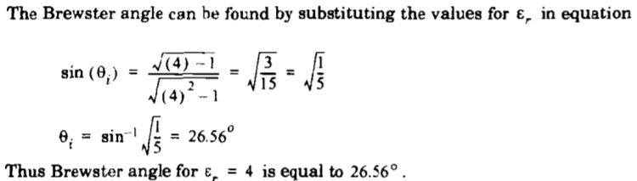
Numerical on Brewster Angle

Slide 12
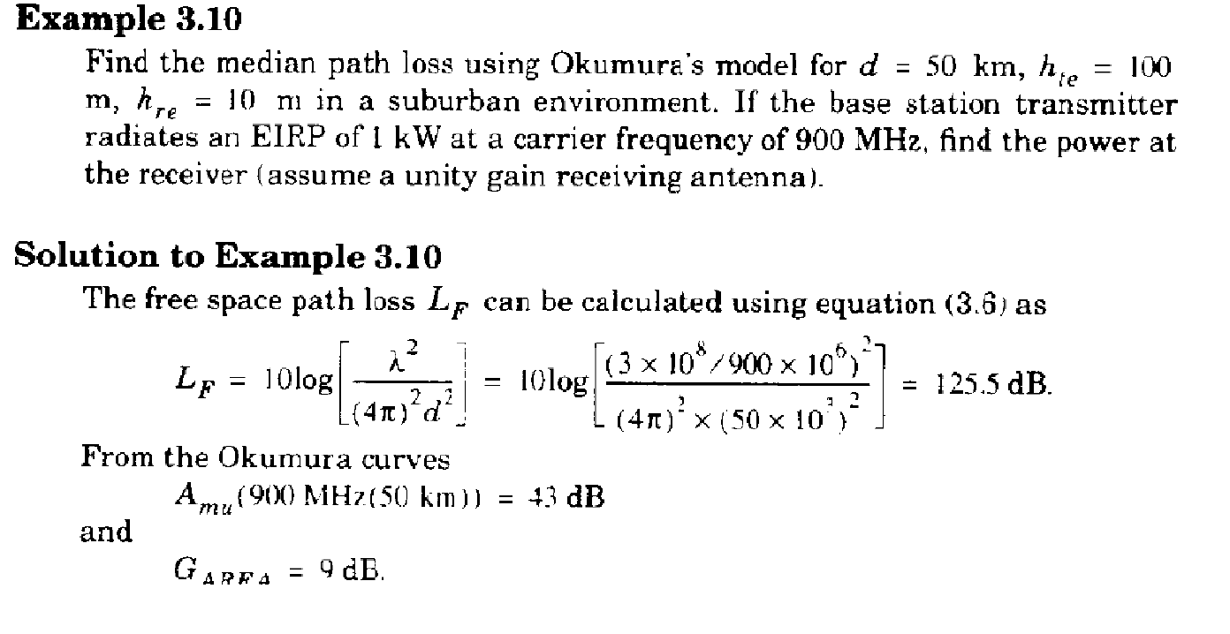
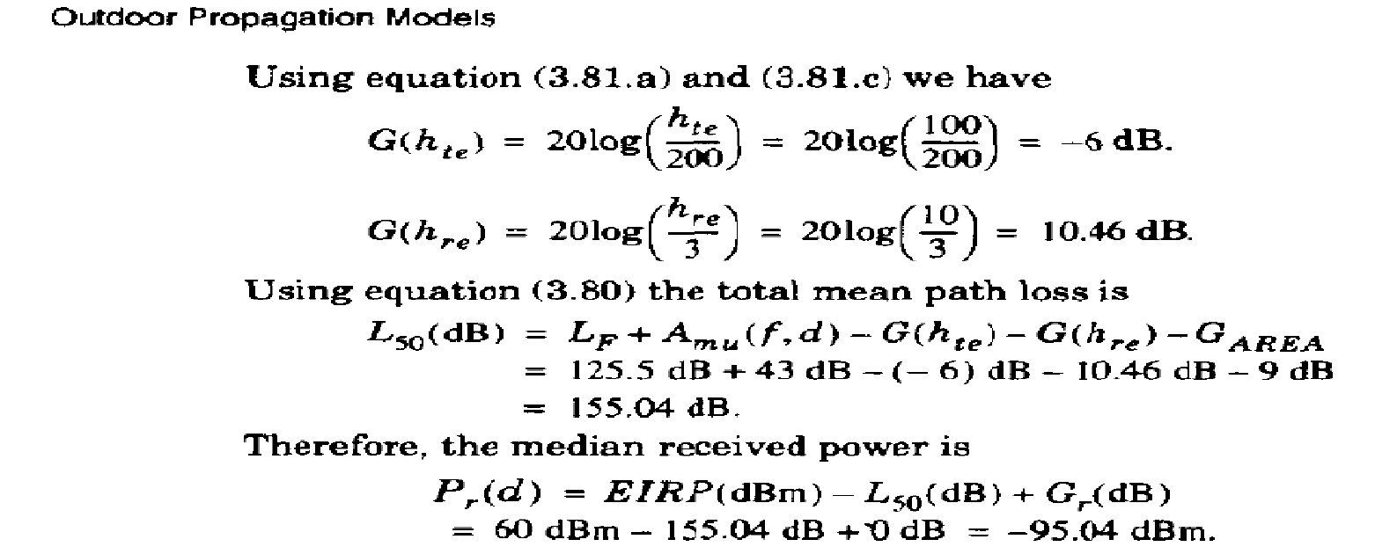
Numerical on Okumara Model

Slide 13
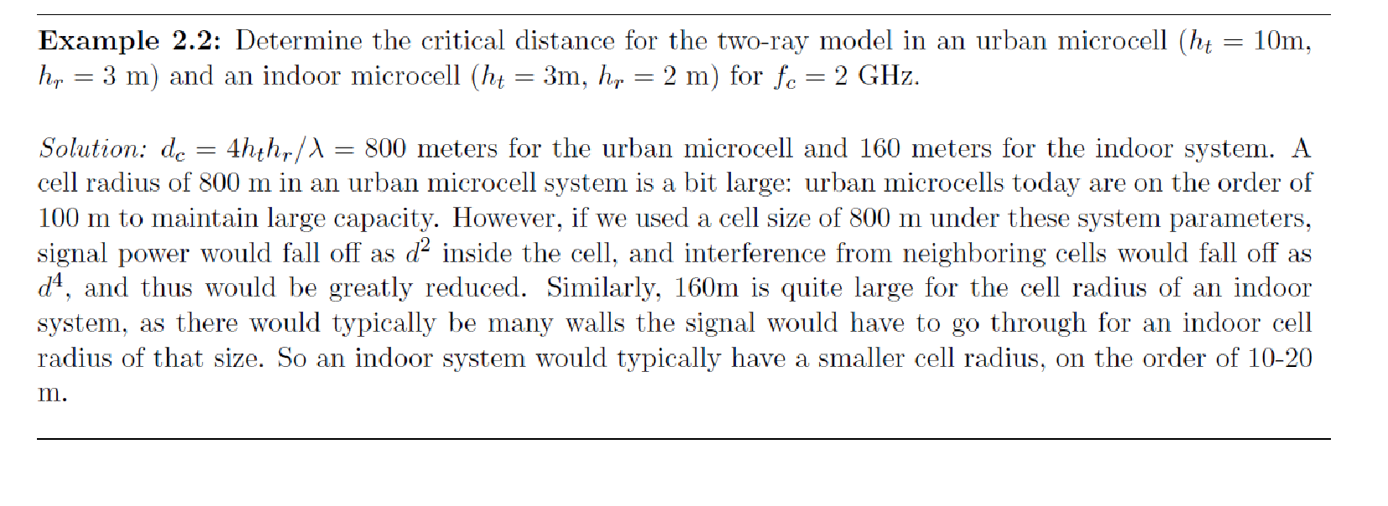
NUMERICALS Contd
Source: Wireless Communications, Andrea Goldsmith, pp 33.

Slide 14
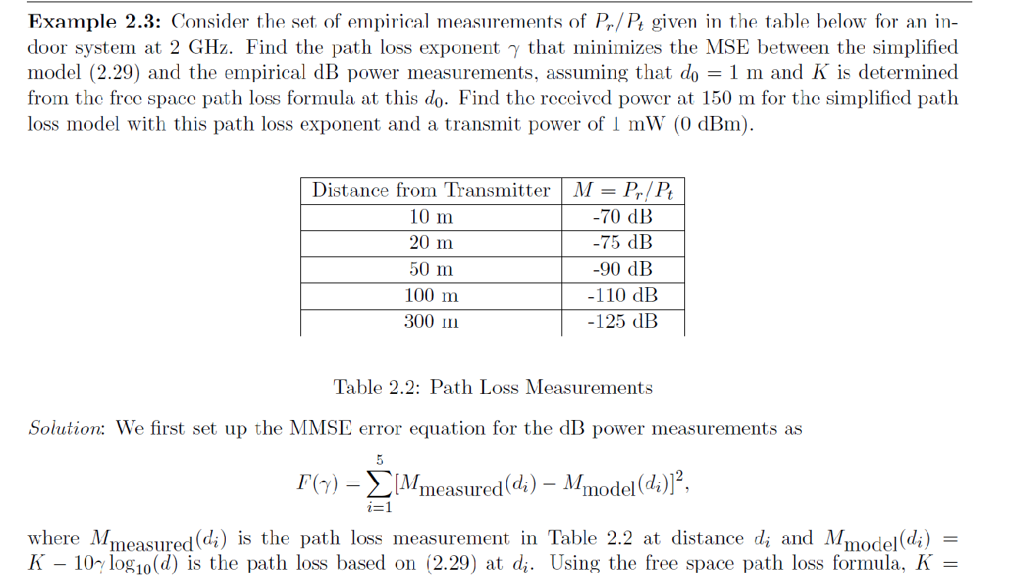
Source: Wireless Communications, Andrea Goldsmith, pp 39 & 40

Slide 15
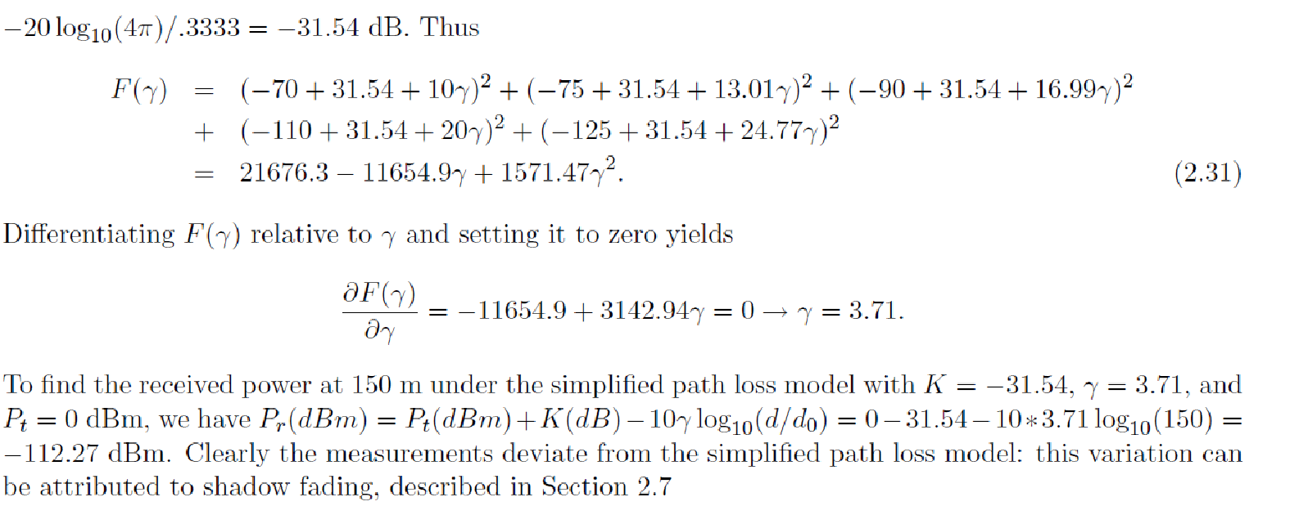
Source: Wireless Communications, Andrea Goldsmith, pp 39 & 40

Slide 16
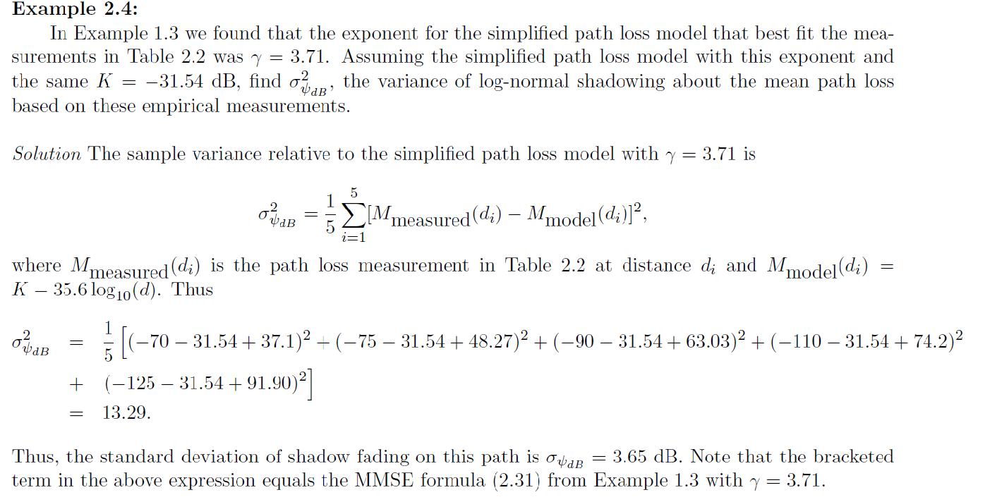
Source: Wireless Communications, Andrea Goldsmith, pp 46

Slide 17
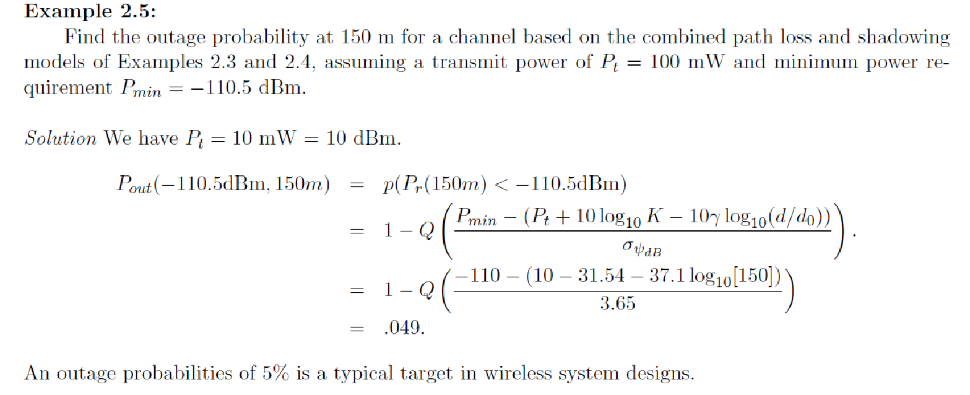
Source: Wireless Communications, Andrea Goldsmith, pp 48

